Slide 1
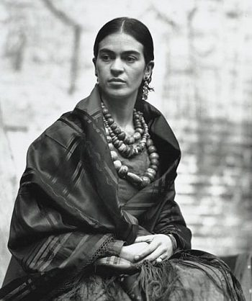
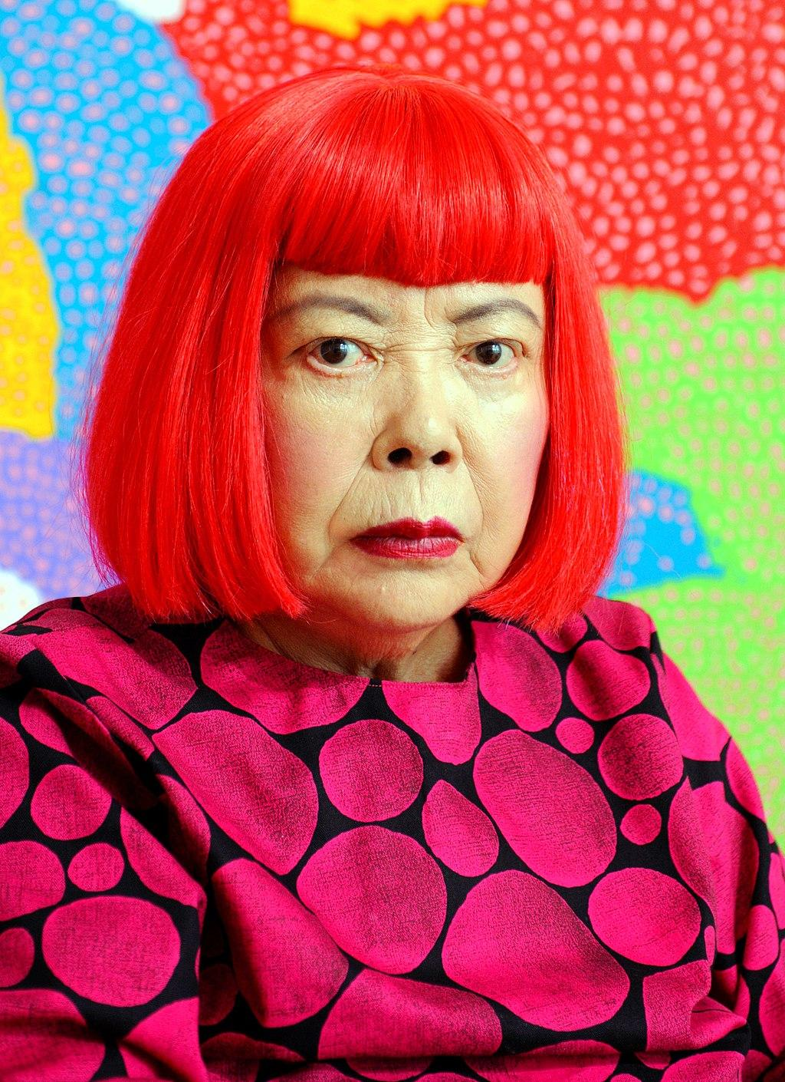
Female Artist
Frida Kahlo
Yayoi Kusama

Slide 2
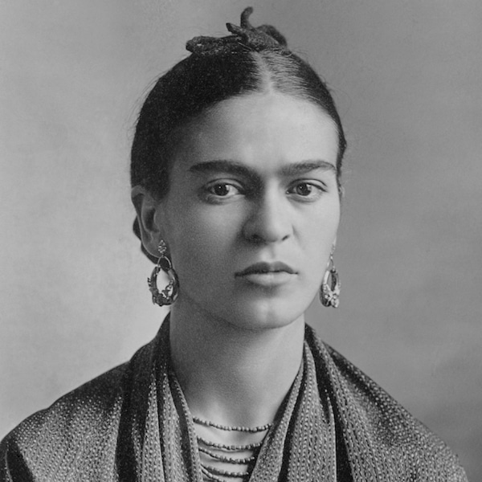
Frida Kahlo
Born as Magdalena Carmen Frida Kahlo on July 6, 1907 in Coyoacan, Mexico City, Mexico.
Died in July 13, 1954 in Coyoacan, Mexico City, Mexico.
She is a Mexican painter.

Slide 3
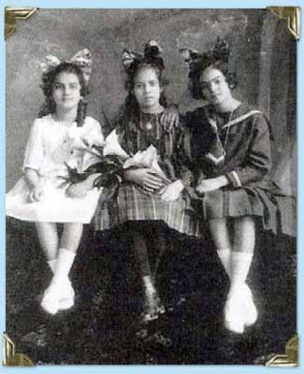
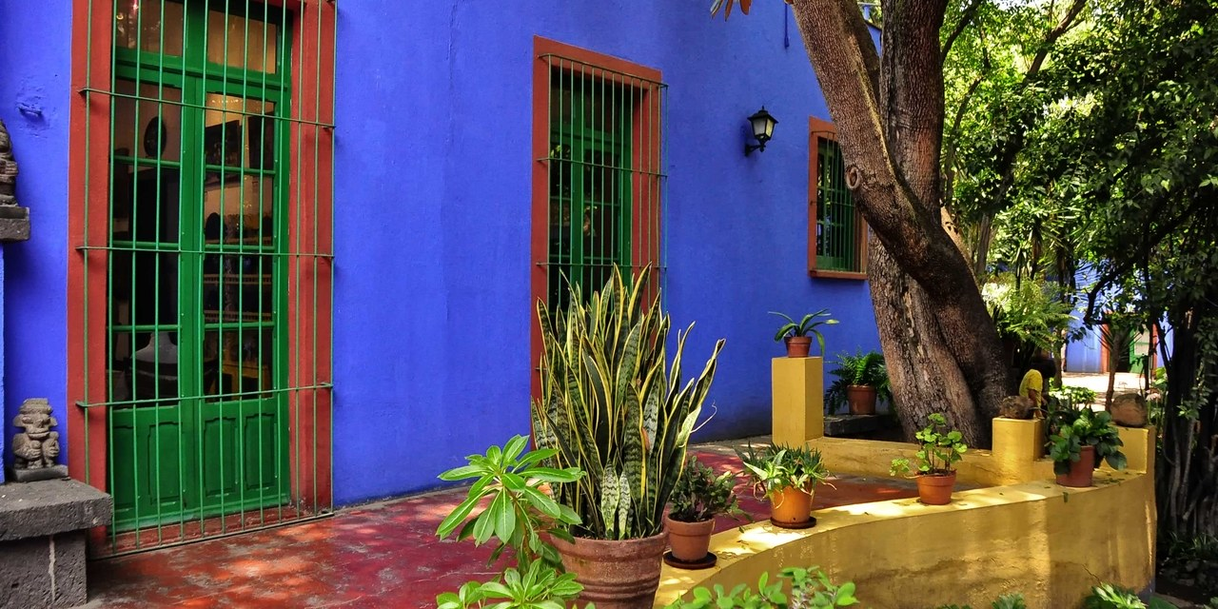
Frida Kahlo was one of 5 children born and raised in Coyoacan, Mexico in their family's home refer as the Blue house. Her father, is a German descendant and photographer. He immigrated to Mexico where he met and married her mother Matilde Calderon, a catholic mestiza, a woman of mixed European and Indian ancestry.
Frida on the right side with her sister and friend.

Slide 4
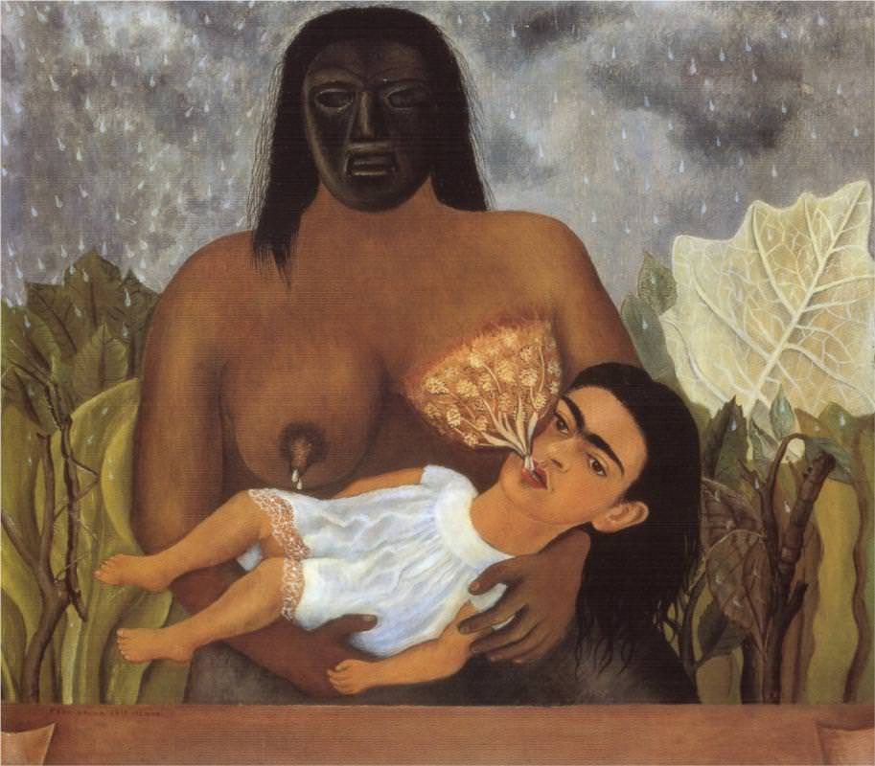
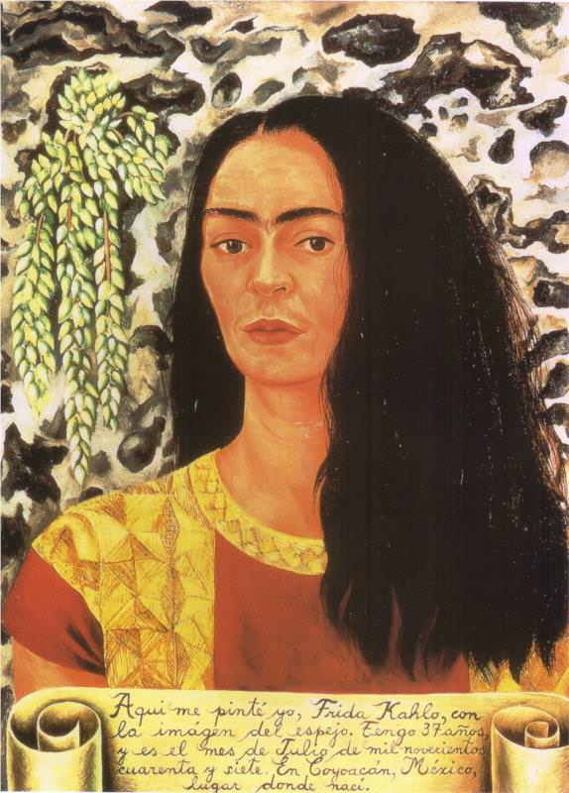
Best known for her symbolic subject matter, colorful oil paintings and self-portraits. Her paintings are deeply personal, she explores several themes such as heritage, struggles with childlessness and femininity.
My nurse and I, 1937
Self Portrait with Loose Hair, 1947

Slide 5
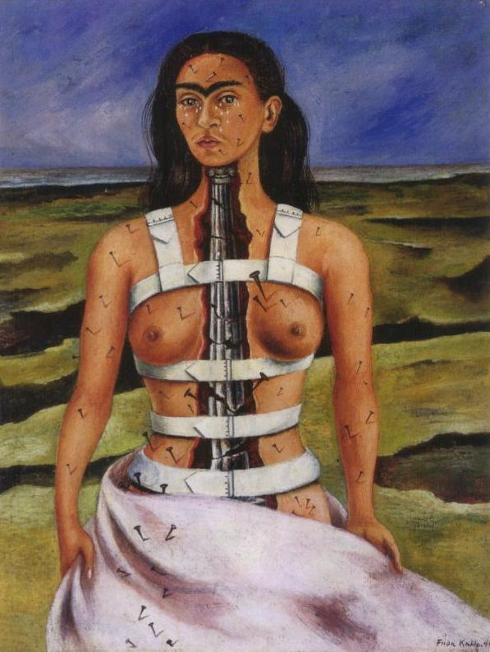
Major events in Frida Kahlo's life
At age of 6, Frida was struck with polio affecting the use of her right leg. Her leg grew very thin, and her foot was stunted in growth.
August 29, 1929 Frida Kahlo married Diego Rivera in a civil ceremony in the town hall of Coyoacan.
She was severely injured in a bus accident in september 1925. Her injuries included a broken spinal cord, collarbone, pelvis and more. She remained with pain for the rest of her life.
While in full cast and temporary mobilization, she painted to occupy her time. During that time she begin to paint her self-portraits. She explain “I paint myself because I am so often alone and because I am the subject I know best.
Diego Rivera and Frida Kahlo divorce on November 6, 1939.
The Broken column, 1944

Slide 6
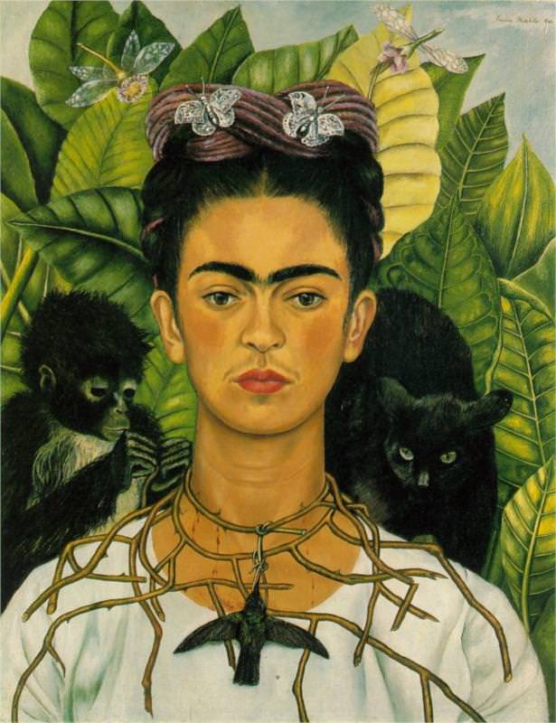
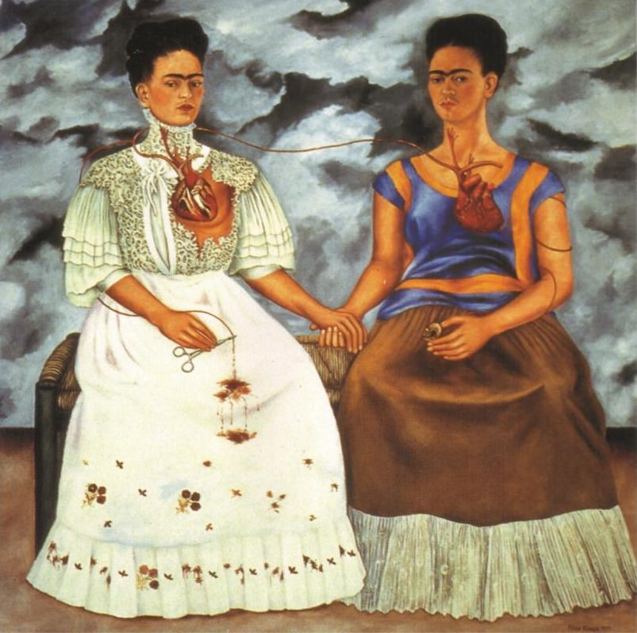
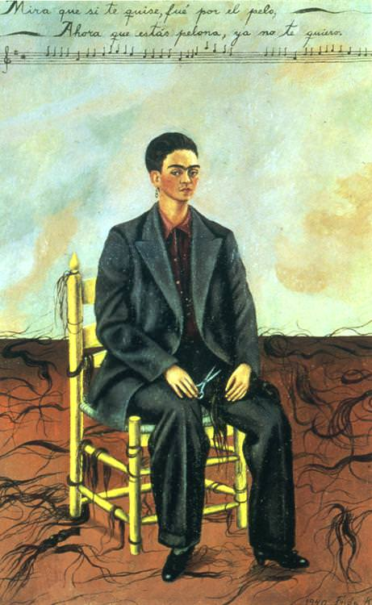
3 most famous works
Self-portrait with Thorn Necklace and Hummingbird, 1940
The two Fridas, 1939
Self-portrait with cropped hair,1940

Slide 7
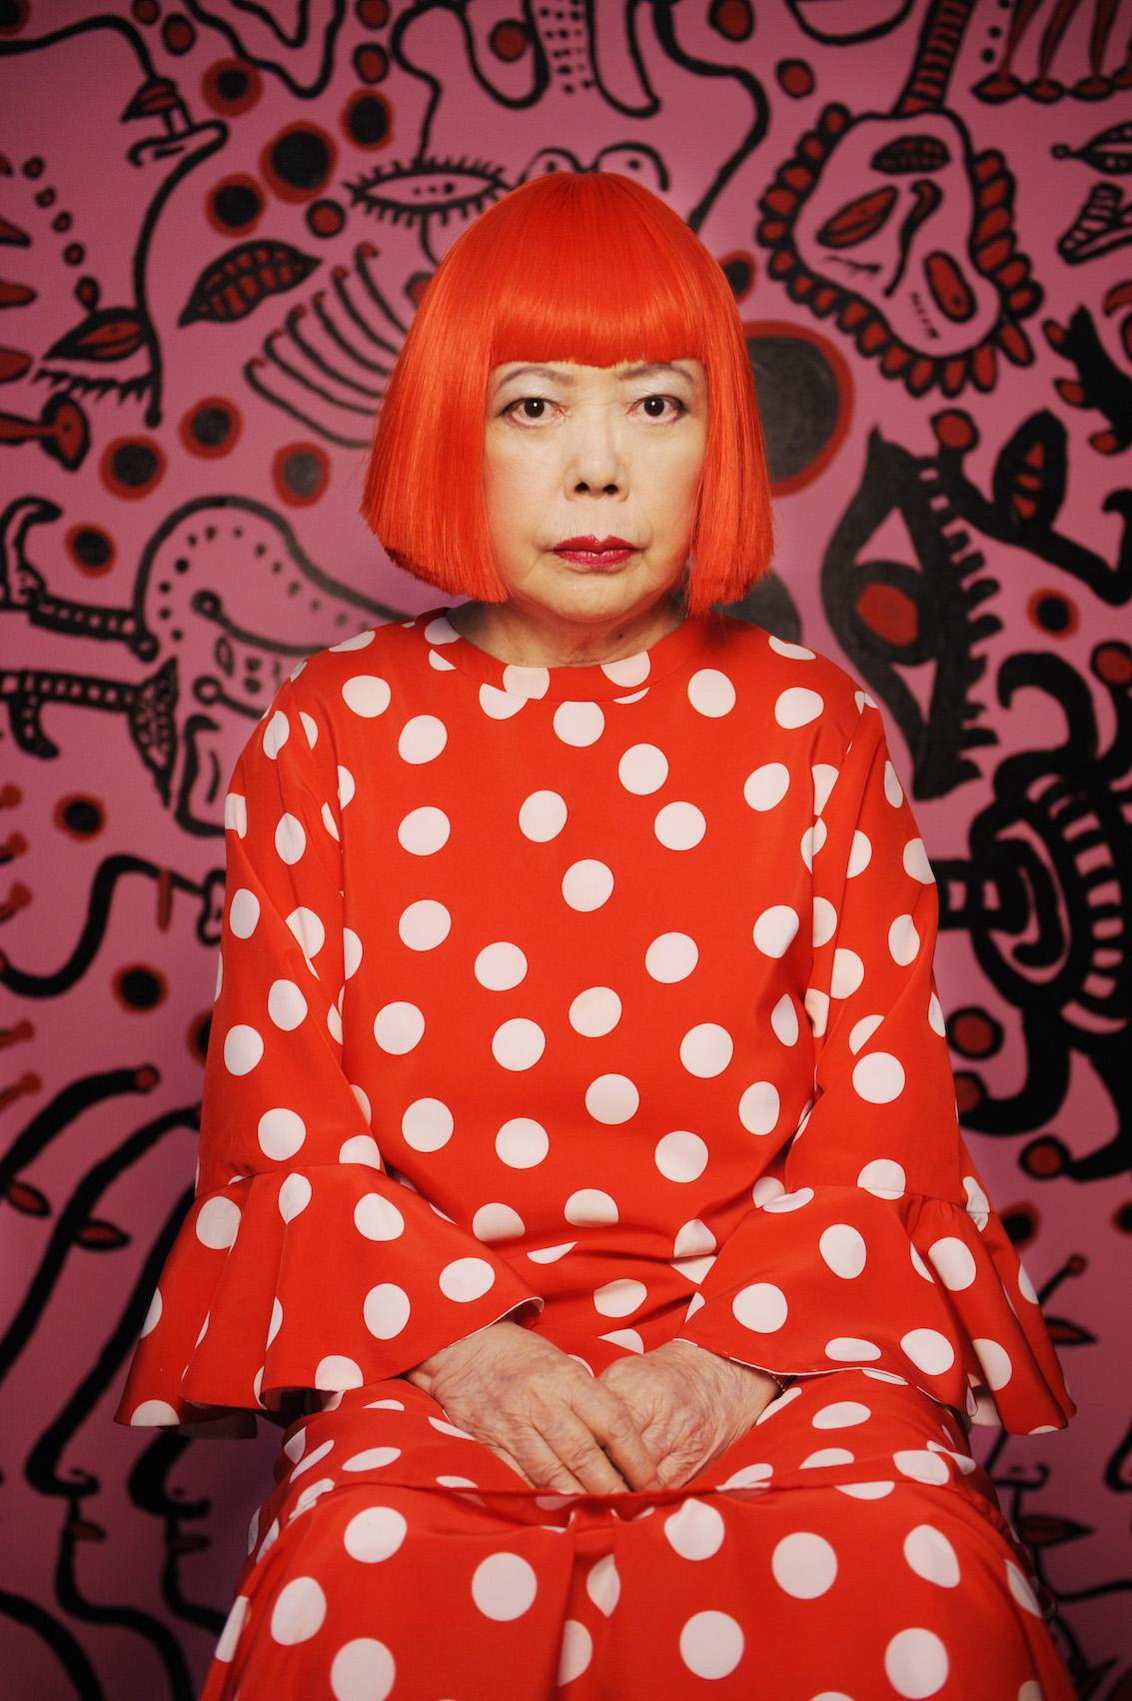
Yayoi Kusama
“The princess of Polka Dots”
Born in March 22, 1929 in Matsumoto, Japan.
Came to the United States in 1950s and lived in New York City.
She is a Japanese abstract painter, sculpture, Performance art, and installations.

Slide 8
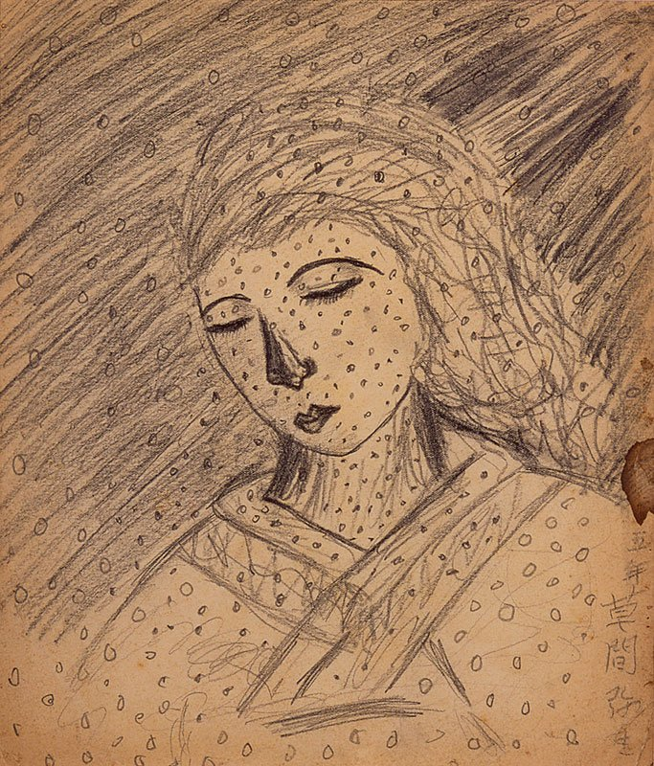
Born into a well-to-do family “The Kusamas” had a successful nursery business on the island of Honshu. The artist’s years of relative comfort were cut by the war in the pacific. She loved drawing and painting and although her parents didn’t want her to pursue a career as an artist, she was determined to be one. Her mother in an attempt to make her stop making art, tores up her drawings, but she made more. When she didn't had the money to buy art materials, she used mud and old sacks to make art.
Portrait of her mother, 1939. Ten year old Kusama.

Slide 9
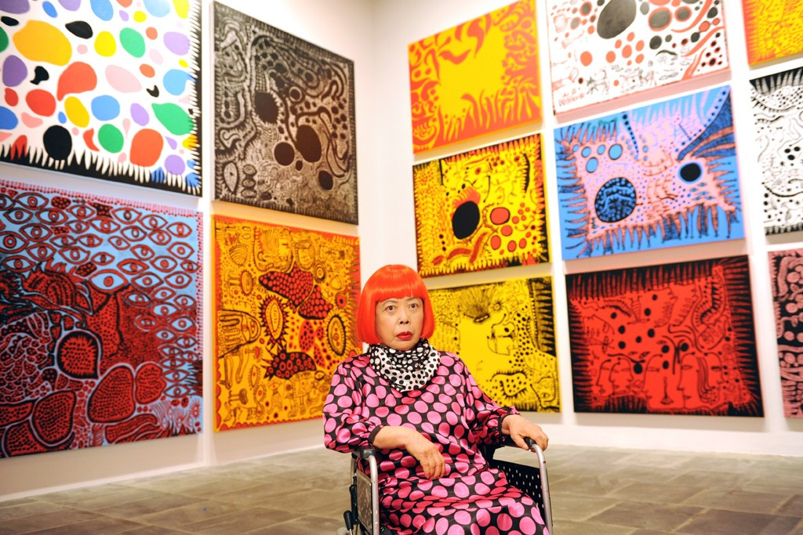
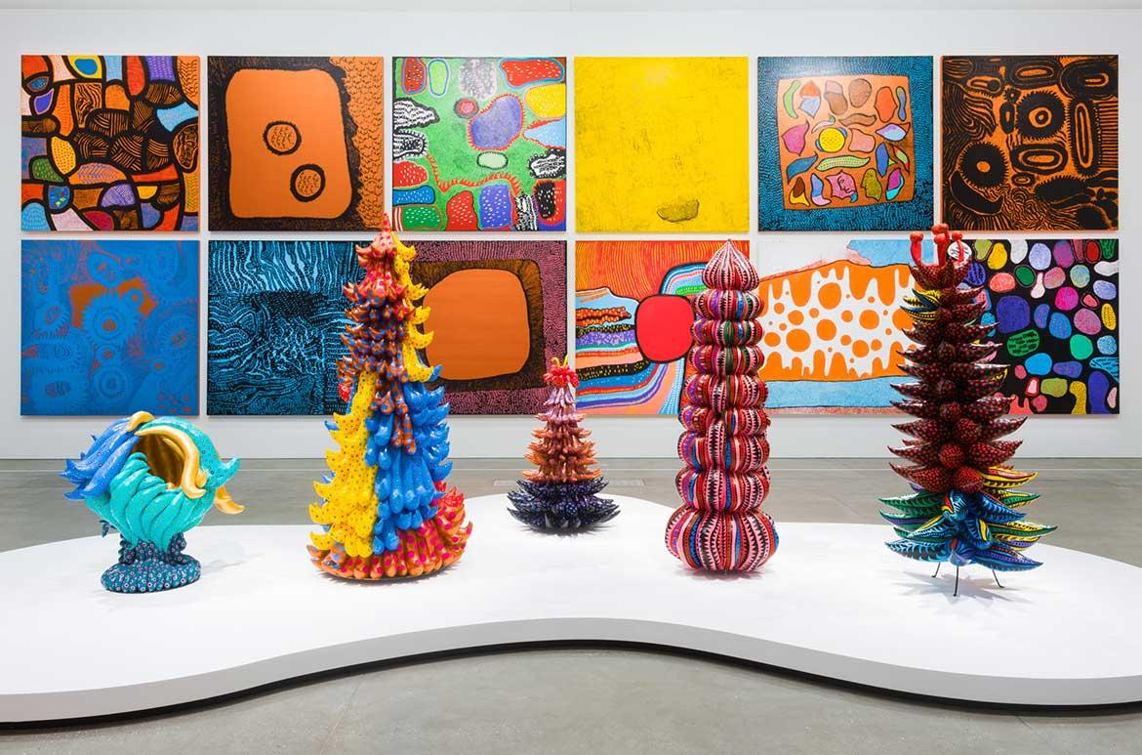
Well known for her Surrealist-inflected paintings, monochromy of the infinity nets, use of dense patterns of polka dots, and her large-scale environments.
Life is the heart of a rainbow

Slide 10
Major events in Yayoi Kusama’s life
During Japan's pacific war she did some farm work, and at the age of 15 she labor in a textile factory that made uniforms and parachutes.
Experiences from the war shape her personal story: She began to have hallucinations, seeing a world covered in nets and dots, experiences in which she felt herself liquidating.
The psychological problems that had perturbed her earlier in life returned, and in spring of 1977 she voluntarily admitted herself to a private hospital.
Infinity Net means “Panic attack” and is inspired by her “fuanshinkei” anxiety neurosis.

Slide 11
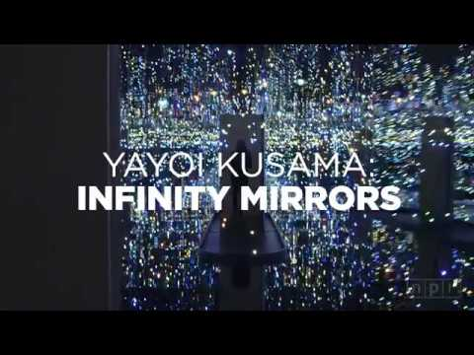
Famous works

